Slide 1
The act of modernization
Adopting patterns and designs that provide you with agility.

Slide 2
What is Digital Transformation?

Slide 3

Why do they care about Digital Transformation?

Slide 4

“How Netflix beat its rivals and survived the 2000s” – CNN Money
“Visiting America's last Blockbuster store” – CBS News
“The Airbnb Effect: Cheaper Rooms For Travelers, Less Revenue For Hotels” - Forbes
“With No Frills and No Commissions, Robinhood App Takes On Big Brokerages” – NY Times
Notes:
Background From Pexel https://www.pexels.com/photo/abundance-blur-bundle-close-up-167538/
Free and Open Source – No Attribution required

Slide 5

It’s all about survival.

Slide 6

Modernization is key to digital transformation

Slide 7


OLD WORLD IT
Marketing analytics
Employees at work
Sales channels
Factories + supply chain
Notes:
In the past, old world IT requirements were fairly static. Marketing was a fairly standard activity through a few channels. Employees would work at offices.

Slide 8




Mobile employees
NEW WORLD IT
Employees at work
Online marketing
Social media
Continuous supply tracking
Factories + supply chain
Online sales + delivery
Just in time production
IoT connected things
Notes:
In the new world of IT, IT has to support new processes, new channels and mediums of content delivery and consumption, with higher frequency of updates and dramatic scale.

Slide 9
Elasticity
Availability
Agility

Slide 10

How do I modernize?

Slide 11
Compliance
Integrated Security
Developer ownership
Iteration
Monitoring
Management
Cultural Shift
Automation

Slide 12
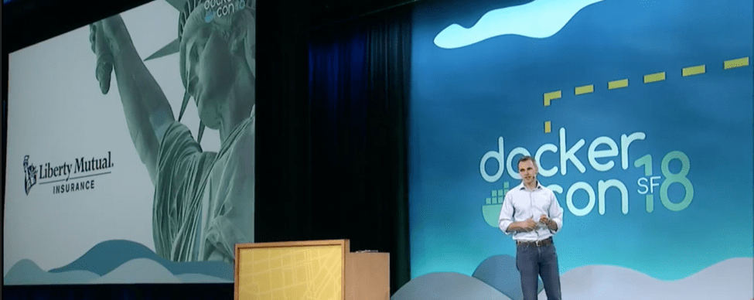
“(Modernization) began to open multiple paths for our teams to modernize traditional applications and move them to the cloud in a more automated, portable and cost effective manner.”
106-year old company
- Eric Drobisewski, Senior Architect
“Multi-Lane Highway” modernization

Slide 13

Modernization means Patterns

Slide 14
Modernization is tough

Slide 15

So, we come up with some solutions.

Slide 16

Containers, Containers
Containers
Notes:
Image From - https://www.pexels.com/photo/cargo-container-lot-906494/
No Attribution Required

Slide 17

Packaging
Distribution
Immutable infrastructure

Slide 18
HELPING CUSTOMERS SCALE CONTAINERS
450+% growth
Hundreds of millions of containers started each week
of millions of container instances
Notes:
In the last couple of years we have seen great adoption of production use cases on Amazon ECS. Our active users are up by more than 450% since 2016 and we are managing containers across millions of instances each month.
In fact, we are witnessing an incredible transition to containers and customers scaling on Amazon ECS, whether its Expedia running its travel platform or Mapbox powering mapping data for some of the most popular websites, Amazon ECS enables these customers to be able to run containers at scale. And indeed, we see hundreds of millions of containers launched every week.

Slide 19

ENABLE FOCUS ON APPLICATIONS
Notes:
Now looking at the feedback we’ve received and where we are really driving containers innovation, we have worked hard over the past year to build a technology that works with Amazon ECS and allows customers to focus entirely on their applications and work with their applications directly at the container or task-level.

Slide 20
CONTAINER
CONTAINER
CONTAINER
CONTAINER
CONTAINER
SELF-SERVICE
SERVICES
SERVICE CATALOG
BUILDS
DEPLOYMENTS
APPLICATION LIFECYCLE AUTOMATION
ORCHESTRATION
CLUSTER SERVICES
SECURITY
TELEMETRY
STORAGE
NETWORK
REGISTRY
PACKAGING FORMAT
HOST OS
AWS
Notes:
This is Why it’s tough.

Slide 21
Be Prescriptive!

Slide 22



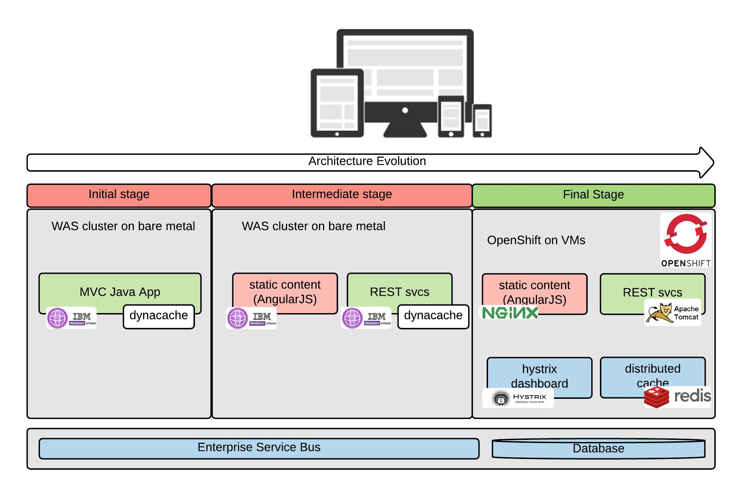

Shift from monolithic applications to microservices
Independently deployable and updatable, limited dependencies
Optimized for agility & accelerated time to market
Monolith
N-Tier
Microservices

Slide 23
Cultural Change is Key!

Slide 24
Failure is success!

Slide 25

Build patterns that accept failure.

Slide 26

Empower your teams with ownership

Slide 27
Thank You!

